Slide 1
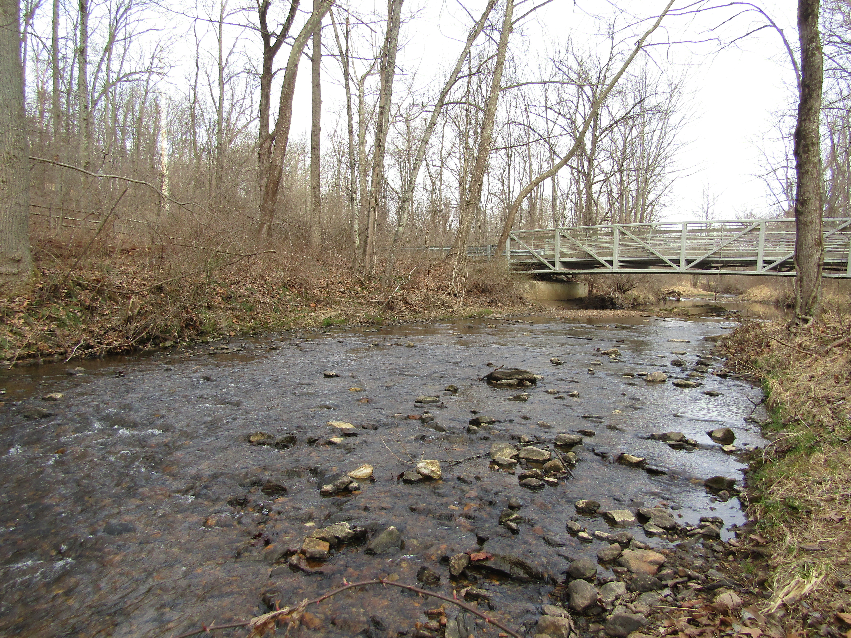
Road salt: A likely driver of long-term benthic macroinvertebrate decline in an urbanizing stream
Nguyen Tien Anh Quach
August 2nd, 2023
Maryland Department of the Environment
Notes:
Road salt: A likely driver of benthic macroinvertebrate decline in urbanizing stream

Slide 2
Outline
Background Information
Initial phase of rapid urban development
Continuing phase of urbanization
Conclusion

Slide 3

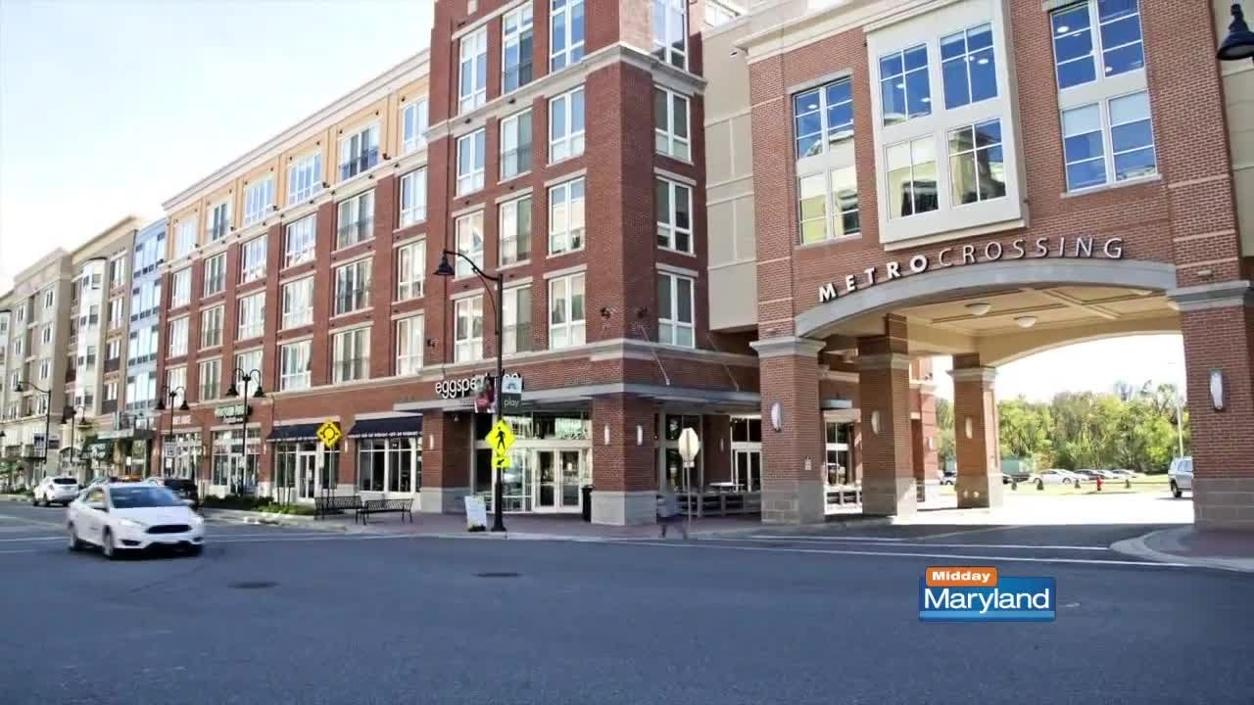
Urban areas continue to expand
USA
89% of population by 2050¹
3.6% - 8.6% increase in urban land cover by 2060²
¹UM CSS, 2021; ²Nowak & Greenfield, 2018
^{Owings Mills, Maryland}
Notes:
Maryland urbanization?

Slide 4
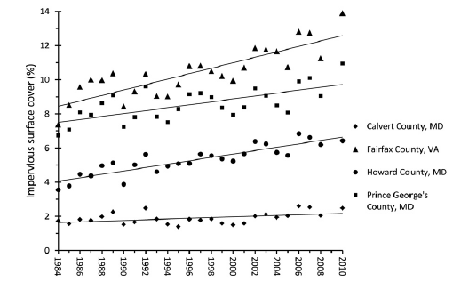
Urban areas continue to expand
USA
89% of population by 2050¹
3.6% - 8.6% increase in urban land cover by 2060²
Baltimore-DC region
Consistent growth from 1984 to 2010
Approx. 11 km² of new impervious surfaces per year³
Sexton et al., 2013
¹UM CSS, 2021; ²Nowak & Greenfield, 2018; ³Sexton et al., 2013
Notes:
Maryland urbanization?

Slide 5
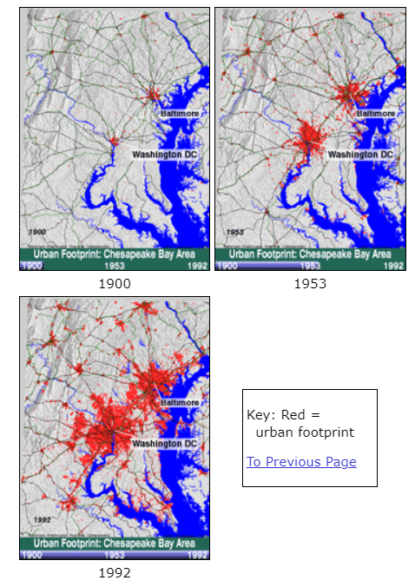
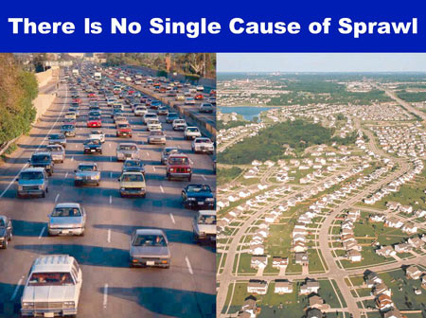
Urban sprawl & the Chesapeake Bay “Pollution Diet”
Consumes large areas of land
Increases reliance on cars
Creates fragmented open spaces
Runoff
Sediment
Nutrients
Notes:
https://www.cbf.org/issues/land-use/the-impact-of-sprawl.html
What is urban sprawl and why is it bad?
Urban sprawl is a form of unplanned urban and suburban development that takes place over a large area and creates a low-density environment with a high segregation between residential and commercial areas with harmful impacts on the people living in these areas.

Slide 6
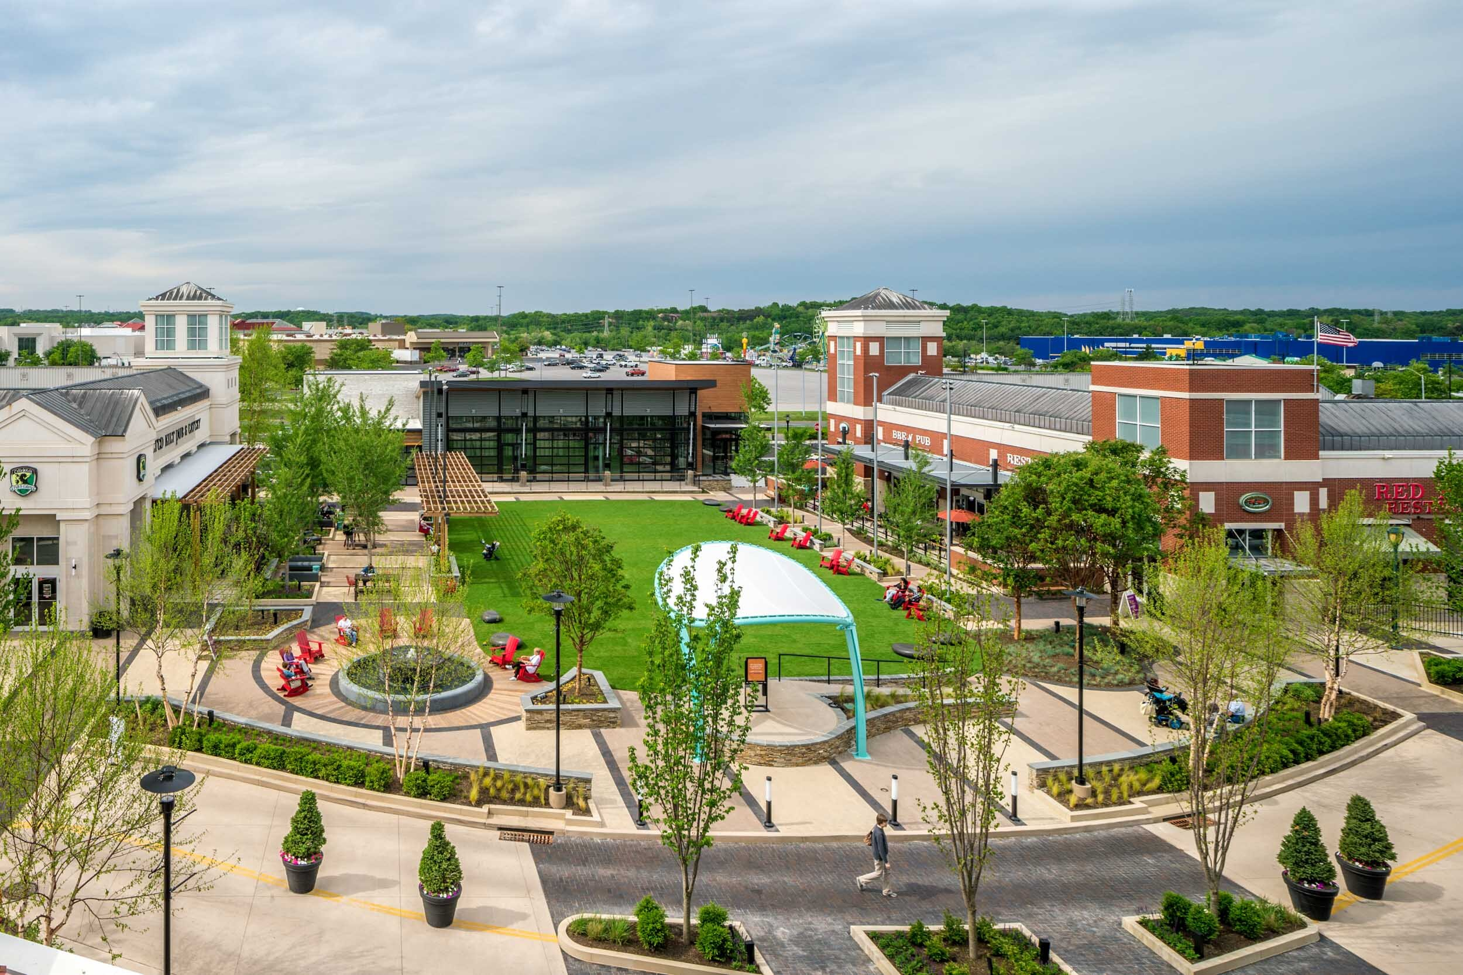

Smart growth as a way to counter urban sprawl
Preserves natural lands
Reduces car dependency and road miles
Better for the Bay?
The Avenue at White Marsh
Notes:
South central PA; between 2000 and 2030;

Slide 7
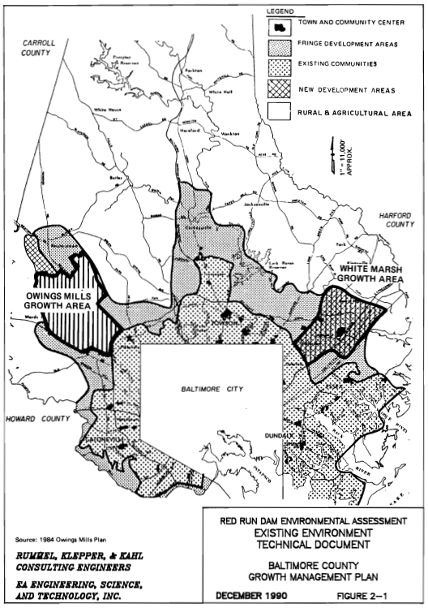
Urban development in Baltimore County
1984: County Council adopted the Master Plan¹
Owings Mills Town Center
How to control stormwater runoff?
Sediment
Nutrients
1990s-2000s: Rapid urban development
¹Baltimore County DPW and DEPRM , 1990
Notes:
Tell a story!
Red Run dam
Owings Mills cluster development: https://www.baltimorecountymd.gov/departments/economicdev/meet-baltimore-county/business-communities/owingsmills.html
The county was trying to manage growth by creating two town centers, including Owings Mills
Construct a regional flood control/stormwater management facility in RR watershed, where growth will occur
=> Basis for 1990 bioassessment

Slide 8
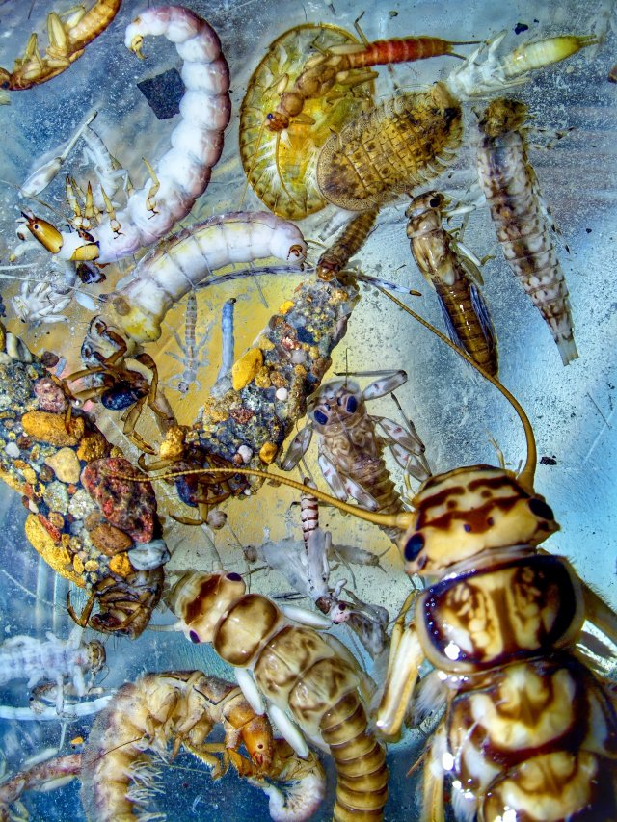
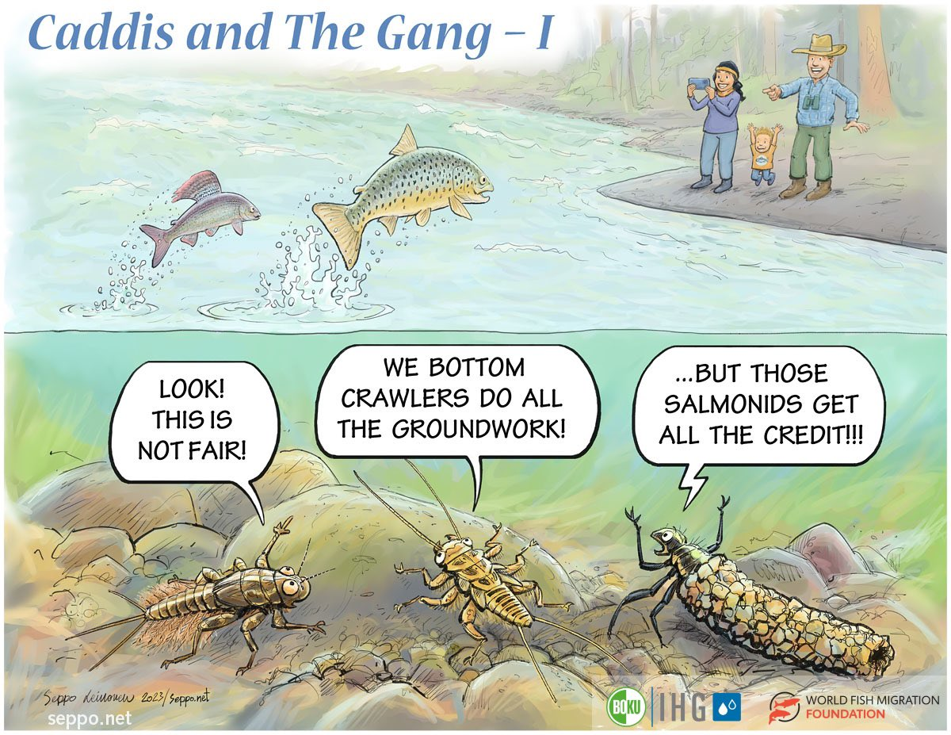
Benthic macroinvertebrates
Abundant, easily sampled
Great indicators of localized conditions => early warning!
Broad range of functional feeding groups and tolerance levels to stressors
Credit: Greg Pond, EPA Region 3

Slide 9
Outline
Background Information
Initial phase of rapid urban development
Continuing phase of urbanization
Conclusion

Slide 10
Research questions
How did (a) land cover and (b) water chemistry change over the period 1987-2009?
How did benthic macroinvertebrate communities respond to rapid urban development?
What was the likely cause of benthic decline?

Slide 11
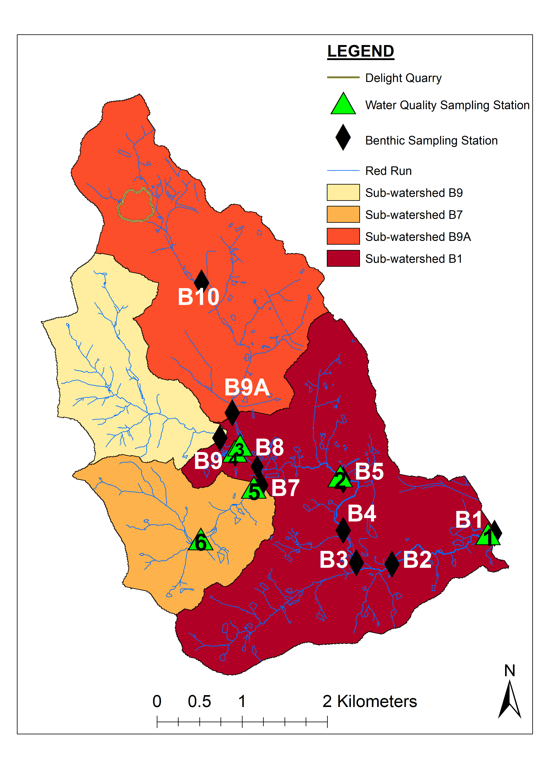
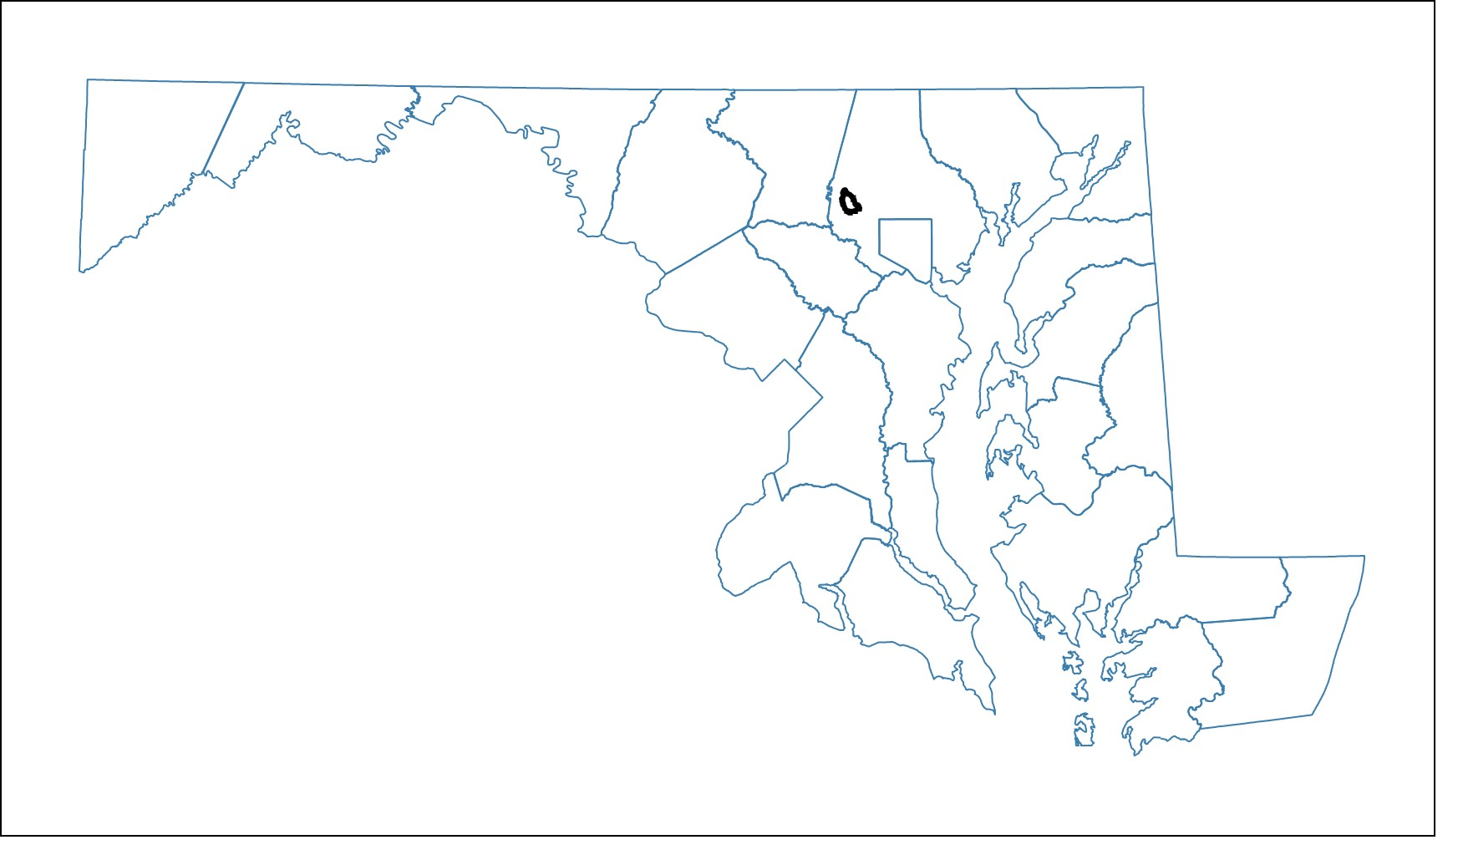
Maryland
Notes:
Image of MD and RR showing benthic and water quality sampling sites
1990 Report finding about brook trout.
2009 Repeated Sampling: Hess
Water quality sampling: Same stations.
=> Importance of the study: Before and After; paired design
https://mdewin64.mde.state.md.us/WSA/TierIIWQ/index.html

Slide 12
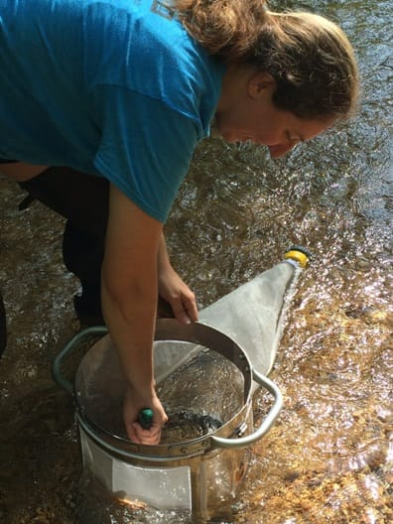
Sampling design
Benthic macroinvertebrates
Hess sampler
Four times a year (1987-1988 & 2009)
Data recorded as density per m²
Water chemistry
Roughly monthly
n₁₉₈₇ = 11; n₂₀₀₉ = 10 -12
Credit: Danelle Haake
Notes:
Image of MD and RR showing benthic and water quality sampling sites
1990 Report finding about brook trout.
2009 Repeated Sampling: Hess
Water quality sampling: Same stations.
=> Importance of the study: Before and After; paired design

Slide 13
Results

Slide 14
Research questions
How did (a) land cover and (b) water chemistry change over the period 1987-2009?
How did benthic macroinvertebrate communities respond to rapid urban development?
What was the likely cause of benthic decline?

Slide 15
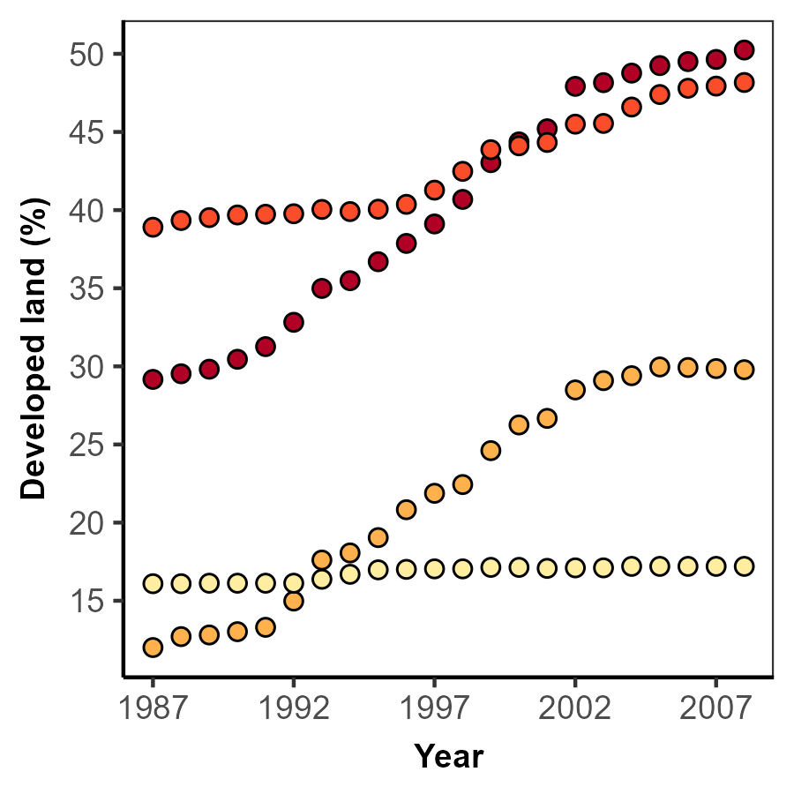
1a. Increase in % developed land varied greatly among the four sub-watersheds.

Slide 16

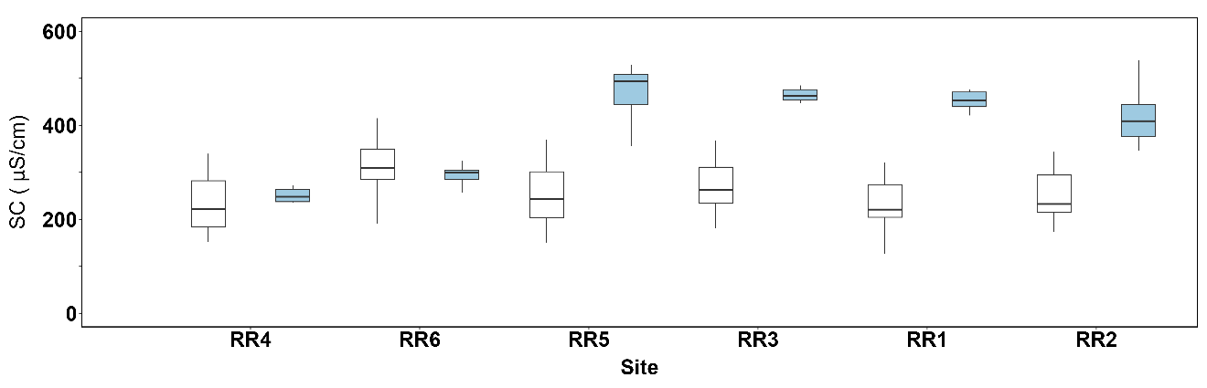
Lowest developed land
Highest developed land

Slide 17
1b. Increases in specific conductance (SC) in sub-watersheds with high % ISA.
Lowest developed land
Highest developed land

Slide 18
1b. Increases in specific conductance (SC) in sub-watersheds with high % ISA.
Lowest developed land
Highest developed land

Slide 19
Research questions
How did (a) land cover and (b) water chemistry change over the period 1987-2009?
How did benthic macroinvertebrate communities respond to rapid urban development?
What was the likely cause of benthic decline?

Slide 20
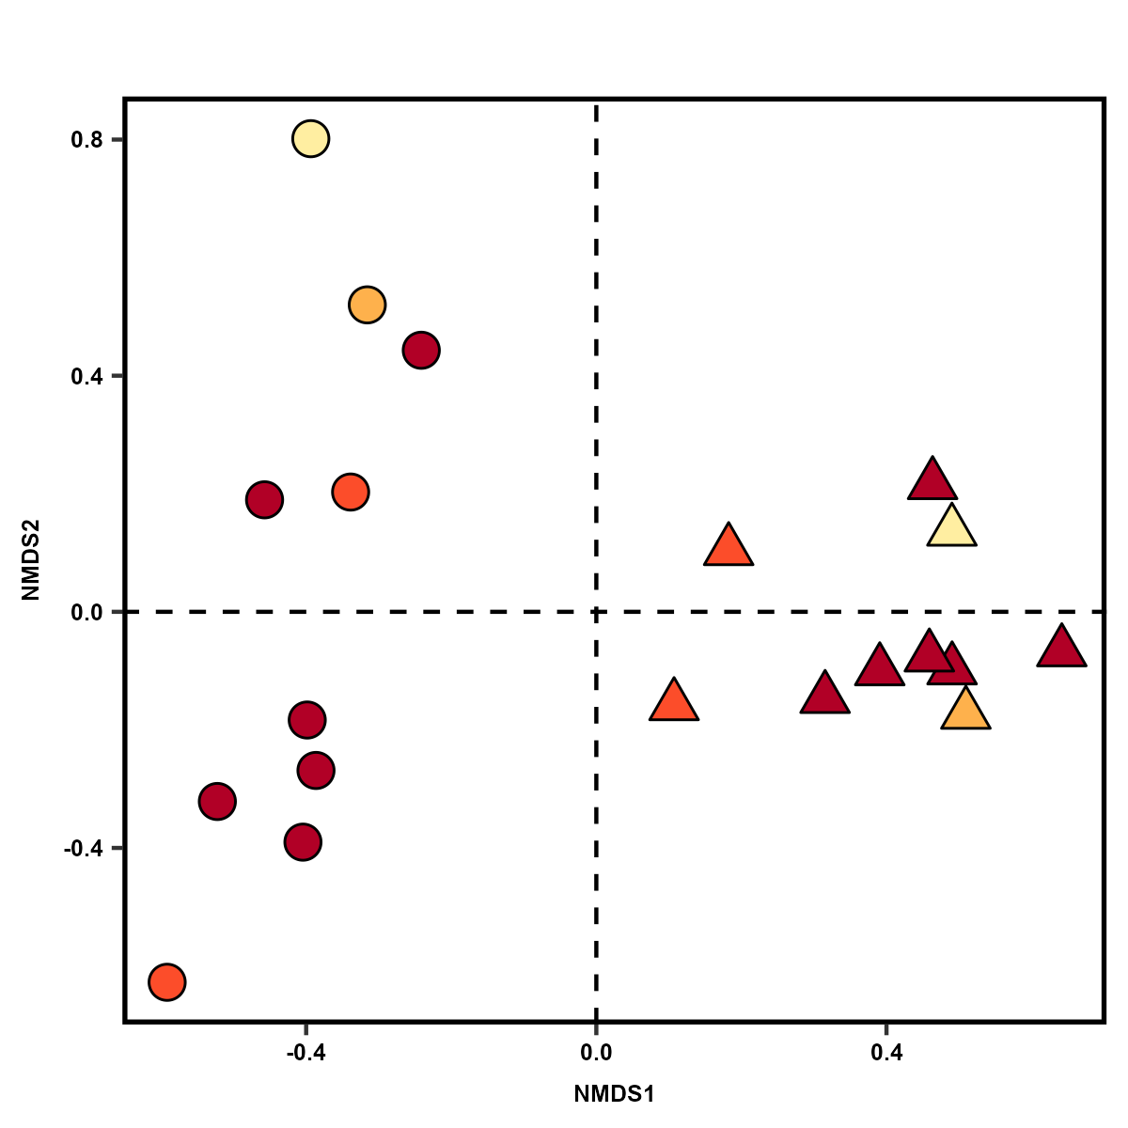
1987-1988 assemblages
1987-1988
2009
2009 assemblages
NMDS ordination of relative abundance of benthic taxa
Early development
Late development

Slide 21
2. Benthic communities in 1987-1988 were distinct from those sampled in 2009.
1987-1988
2009
Early development
Late development

Slide 22
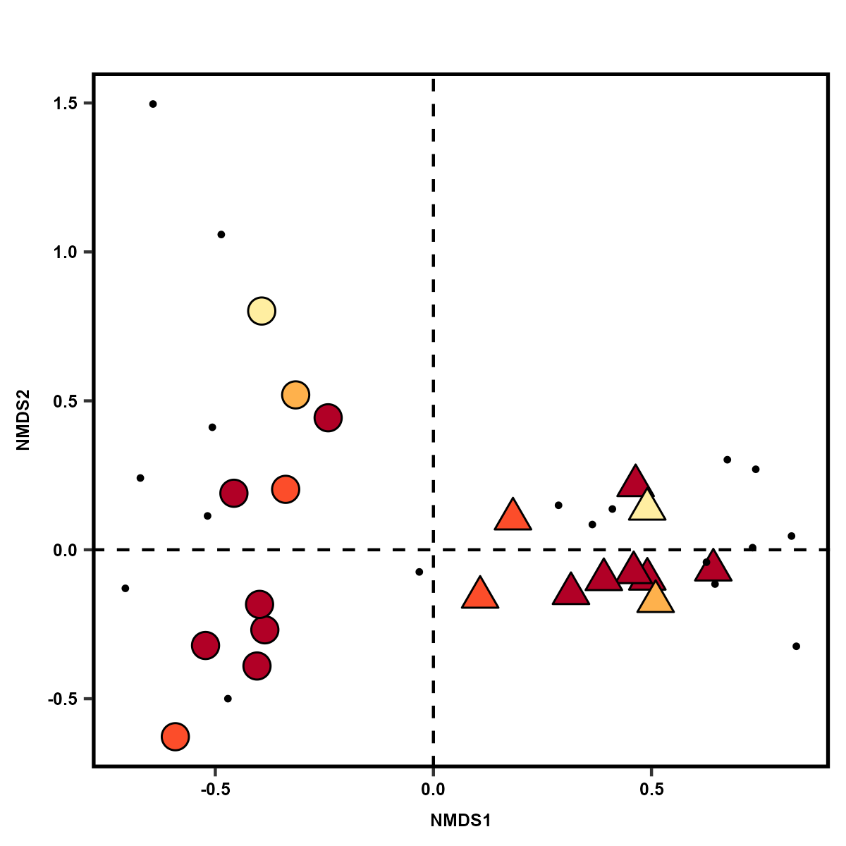
1987-1988
2009
NMDS ordination of relative
abundance of benthic taxa
with an overlay
of taxa scores
Early development
Late development

Slide 23
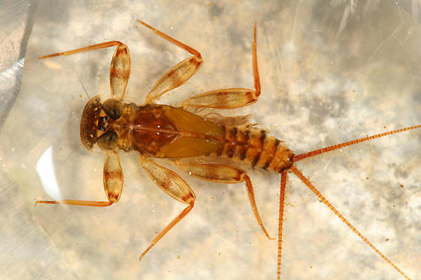

Sensitive
Tolerance value $≤$ 3/10
BugGuide.Net
Maccaffertium (Ephemeroptera:Heptageniidae)
3
Southerland et al., 2005
Notes:
TV: expert observation/opinions;

Slide 24
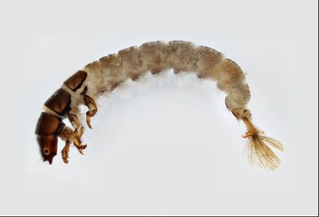

Sensitive
Tolerant
Tolerance value $≤$ 3/10
Tolerance value $>$3/10
Macroinvertebrates.org
BugGuide.Net
Maccaffertium (Ephemeroptera:Heptageniidae)
3
Hydropsyche (Trichoptera:Hydropsychidae)
7.5
Southerland et al., 2005
Notes:
Hypotheses:
Null hypothesis: Taxa were lost totally due to random chance.
A priori/alternative hypothesis: Based on changes in land cover and water chemistry, urban intolerant taxa were lost.
Tool used: Randomization test
Test statistic: Mean tolerance value of lost taxa
Results: At B1, B2, and B7, null hypothesis rejected.

Slide 25
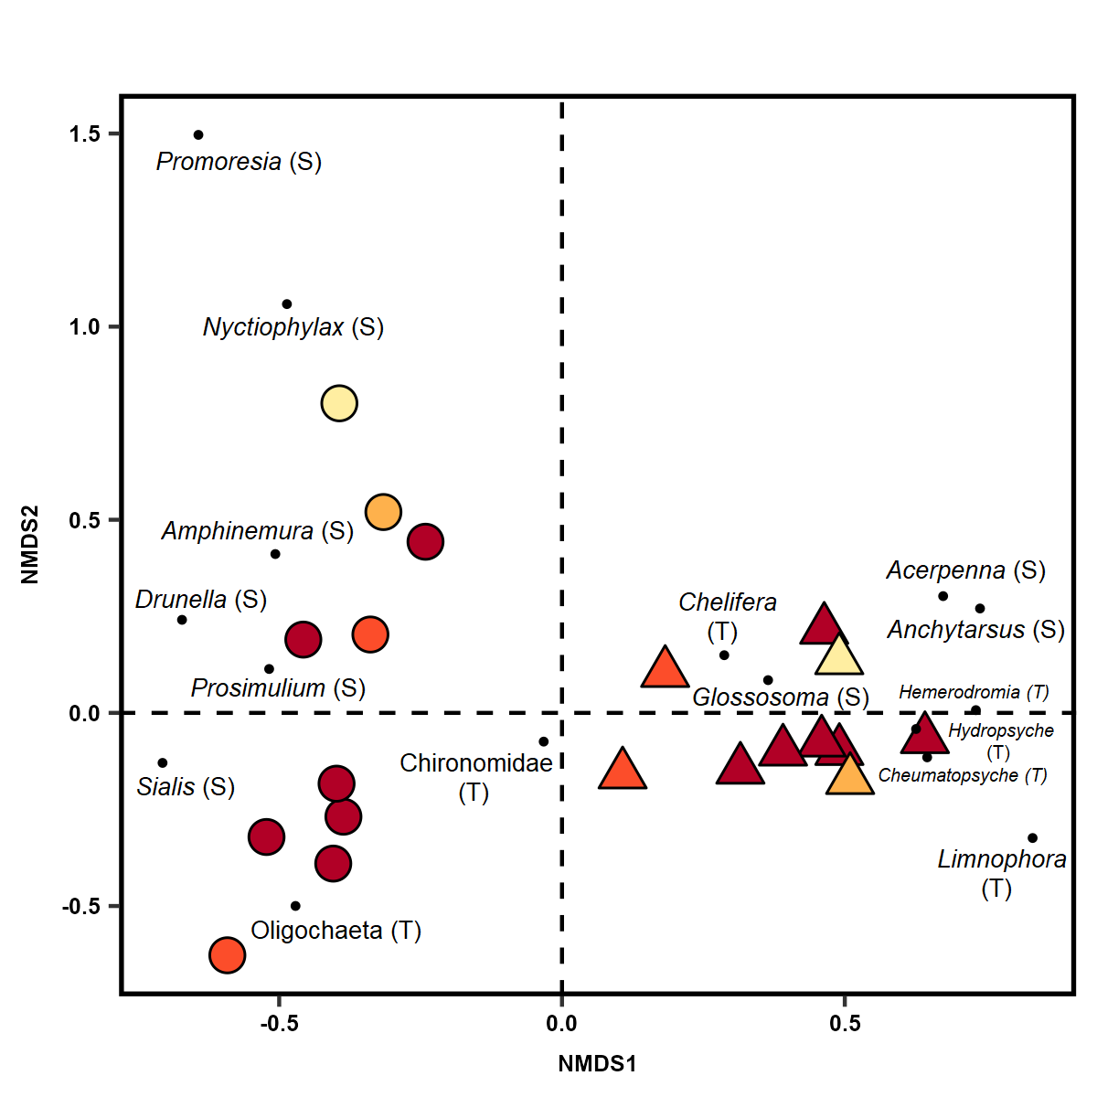
2. Benthic communities in 1987-1988 contained more sensitive taxa than those sampled in 2009.
6S & 2T
3S & 5T
(S) : sensitive taxa
(T) : tolerant taxa
1987-1988
2009
Early development
Late development

Slide 26
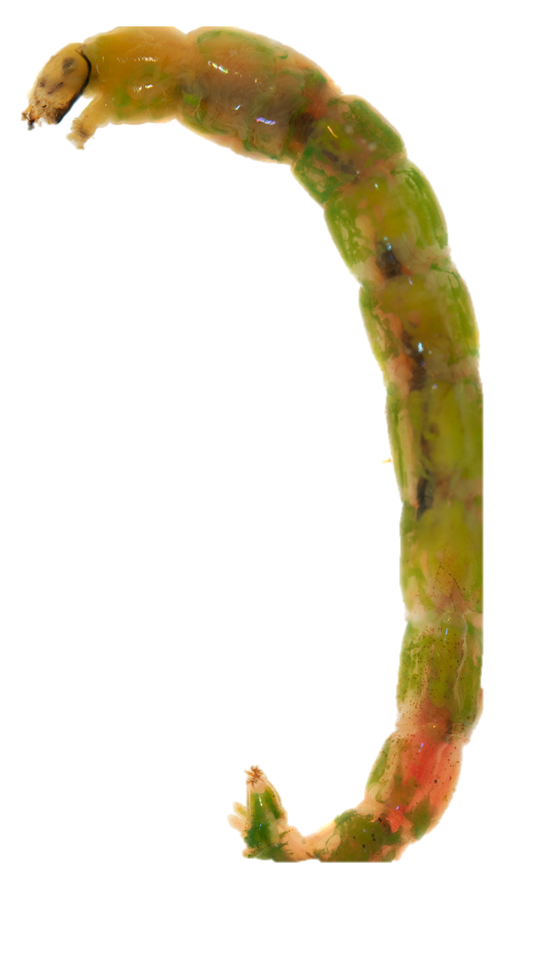
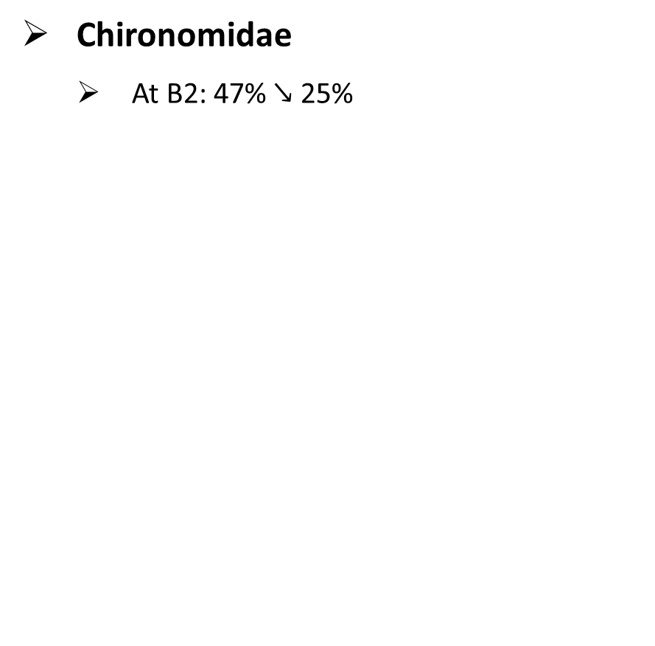
(S) : sensitive taxa
(T) : tolerant taxa
Chironomidae
At B2: 47% $↘$ 25%
Early development
Late development

Slide 27
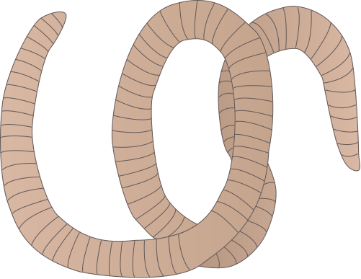
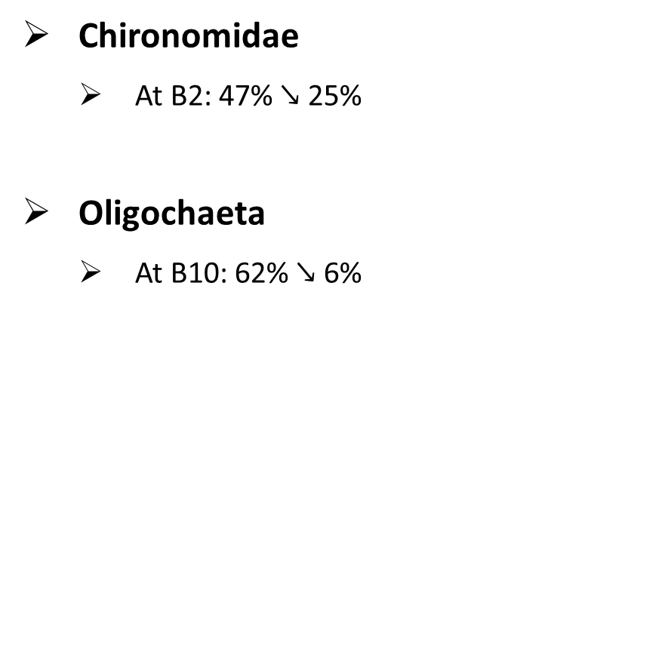
(S) : sensitive taxa
(T) : tolerant taxa
Chironomidae
At B2: 47% $↘$ 25%
Oligochaeta
At B10: 62% $↘$ 6%
Early development
Late development

Slide 28
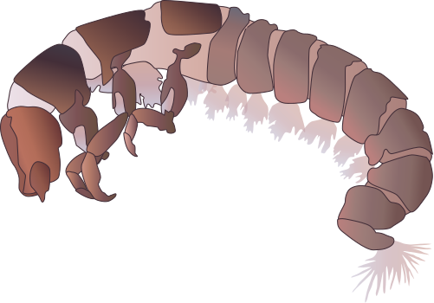
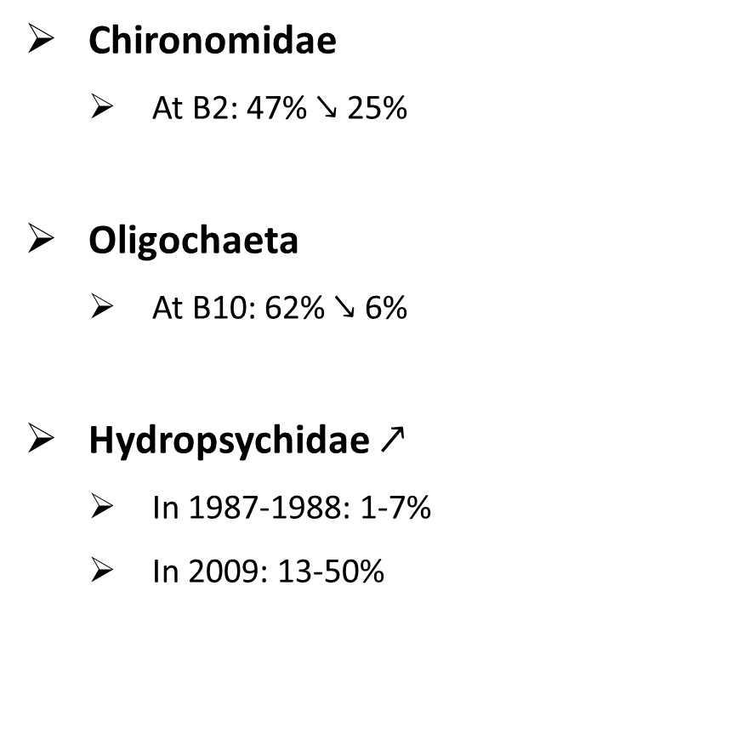
2. Relative abundances of Chironomidae $↘$, Oligochaeta $↘$, and Hydropsychidae $↗$.
(S) : sensitive taxa
(T) : tolerant taxa
Chironomidae
At B2: 47% $↘$ 25%
Oligochaeta
At B10: 62% $↘$ 6%
Hydropsychidae $↗$
In 1987-1988: 1-7%
In 2009: 13-50%
Early development
Late development

Slide 29
Research questions
How did (a) land cover and (b) water chemistry change over the period 1987-2009?
How did benthic macroinvertebrate communities respond to rapid urban development?
What was the likely cause of benthic decline?

Slide 30
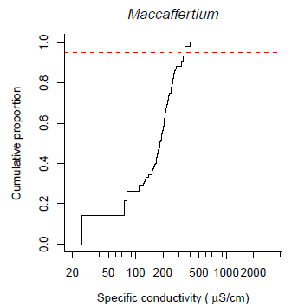
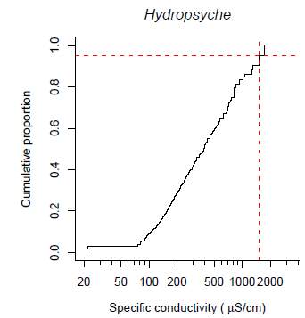
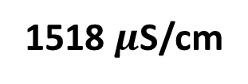
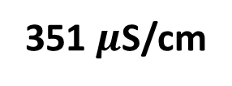
XC₉₅ (extirpation level of specific conductance)
At which 95% of a benthic genus is extirpated
Developed for Northern Piedmont of Maryland¹
351 $μ$S/cm
1518 $μ$S/cm
Cormier et al., 2018
Notes:
Hypotheses:
Null hypothesis: Taxa were lost totally due to random chance.
A priori/alternative hypothesis: Based on changes in land cover and water chemistry, urban intolerant taxa were lost.
Tool used: Randomization test
Test statistic: Mean tolerance value of lost taxa
Results: At B1, B2, and B7, null hypothesis rejected.

Slide 31
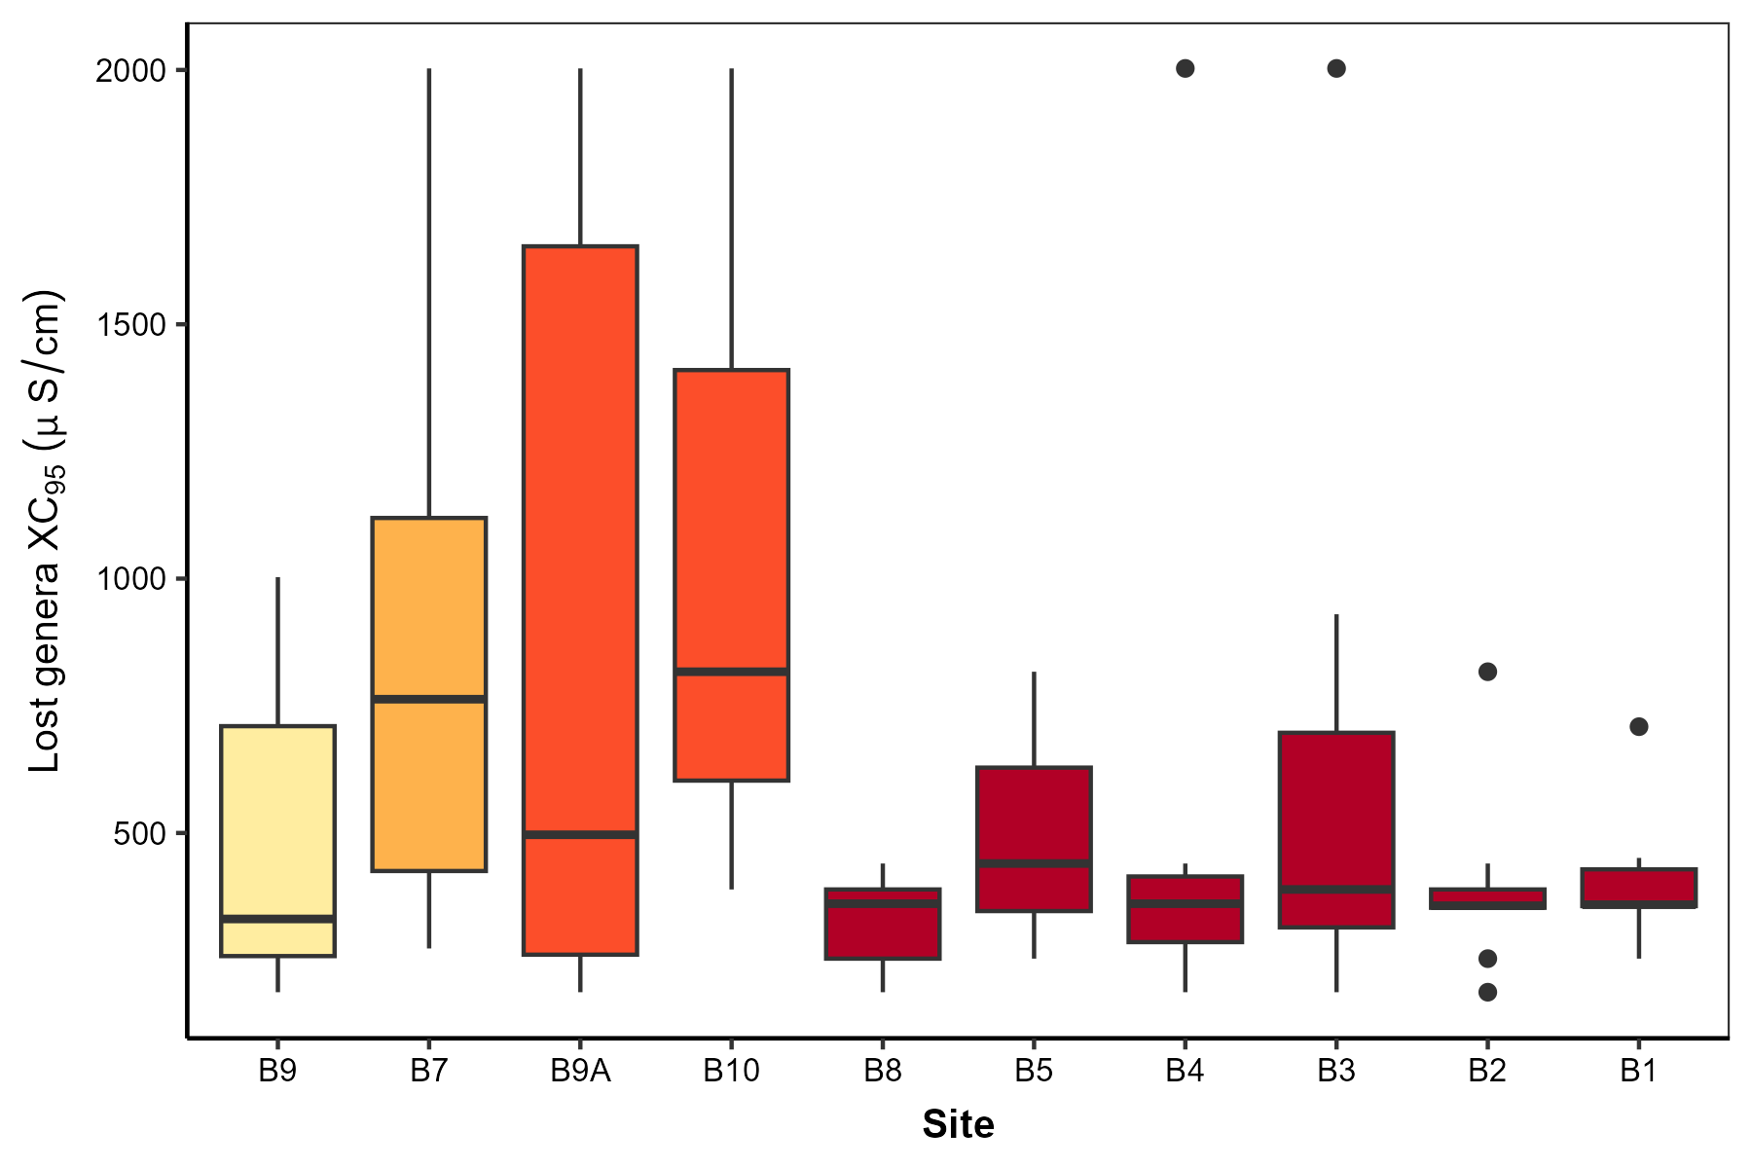
Notes:
Hypotheses:
Null hypothesis: Taxa were lost totally due to random chance.
A priori/alternative hypothesis: Based on changes in land cover and water chemistry, urban intolerant taxa were lost.
Tool used: Randomization test
Test statistic: Mean tolerance value of lost taxa
Results: At B1, B2, and B7, null hypothesis rejected.

Slide 32
Notes:
Hypotheses:
Null hypothesis: Taxa were lost totally due to random chance.
A priori/alternative hypothesis: Based on changes in land cover and water chemistry, urban intolerant taxa were lost.
Tool used: Randomization test
Test statistic: Mean tolerance value of lost taxa
Results: At B1, B2, and B7, null hypothesis rejected.

Slide 33
Notes:
Hypotheses:
Null hypothesis: Taxa were lost totally due to random chance.
A priori/alternative hypothesis: Based on changes in land cover and water chemistry, urban intolerant taxa were lost.
Tool used: Randomization test
Test statistic: Mean tolerance value of lost taxa
Results: At B1, B2, and B7, null hypothesis rejected.

Slide 34
Notes:
Hypotheses:
Null hypothesis: Taxa were lost totally due to random chance.
A priori/alternative hypothesis: Based on changes in land cover and water chemistry, urban intolerant taxa were lost.
Tool used: Randomization test
Test statistic: Mean tolerance value of lost taxa
Results: At B1, B2, and B7, null hypothesis rejected.

Slide 35
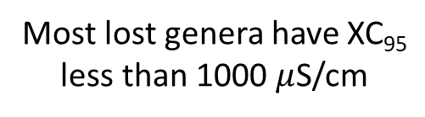
3. Significant loss of salt-sensitive genera occurred at downstream mainstem stations.
Most lost genera have XC₉₅ less than 1000 $μ$S/cm
Notes:
Hypotheses:
Null hypothesis: Taxa were lost totally due to random chance.
A priori/alternative hypothesis: Based on changes in land cover and water chemistry, urban intolerant taxa were lost.
Tool used: Randomization test
Test statistic: Mean tolerance value of lost taxa
Results: At B1, B2, and B7, null hypothesis rejected.

Slide 36
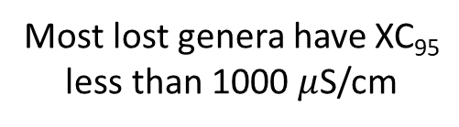
3. Significant loss of salt-sensitive genera occurred at downstream mainstem stations.
Most lost genera have XC₉₅ less than 1000 $μ$S/cm
p < 0.05
*
*
*
*
*
Notes:
Hypotheses:
Null hypothesis: Taxa were lost totally due to random chance.
A priori/alternative hypothesis: Based on changes in land cover and water chemistry, urban intolerant taxa were lost.
Tool used: Randomization test
Test statistic: Mean tolerance value of lost taxa
Results: At B1, B2, and B7, null hypothesis rejected.

Slide 37

3. Significant loss of salt-sensitive genera occurred at downstream mainstem stations.
Maximum SC recorded in 2009
Most lost genera have XC₉₅ less than 1000 $μ$S/cm
Estimated maximum SC
*
*
*
*
*
*
*
*
*
*
Notes:
Hypotheses:
Null hypothesis: Taxa were lost totally due to random chance.
A priori/alternative hypothesis: Based on changes in land cover and water chemistry, urban intolerant taxa were lost.
Tool used: Randomization test
Test statistic: Mean tolerance value of lost taxa
Results: At B1, B2, and B7, null hypothesis rejected.

Slide 38


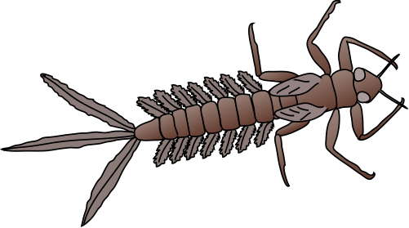
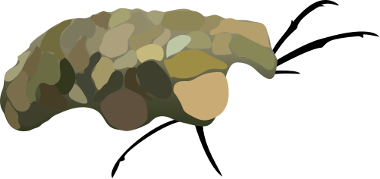
3. Significant loss of salt-sensitive genera occurred at downstream mainstem stations.
Maximum SC recorded in 2009
Estimated maximum SC
Most lost genera have XC₉₅ less than 1000 $μ$S/cm
*
*
*
*
*
*
*
*
*
*
Notes:
Hypotheses:
Null hypothesis: Taxa were lost totally due to random chance.
A priori/alternative hypothesis: Based on changes in land cover and water chemistry, urban intolerant taxa were lost.
Tool used: Randomization test
Test statistic: Mean tolerance value of lost taxa
Results: At B1, B2, and B7, null hypothesis rejected.

Slide 39
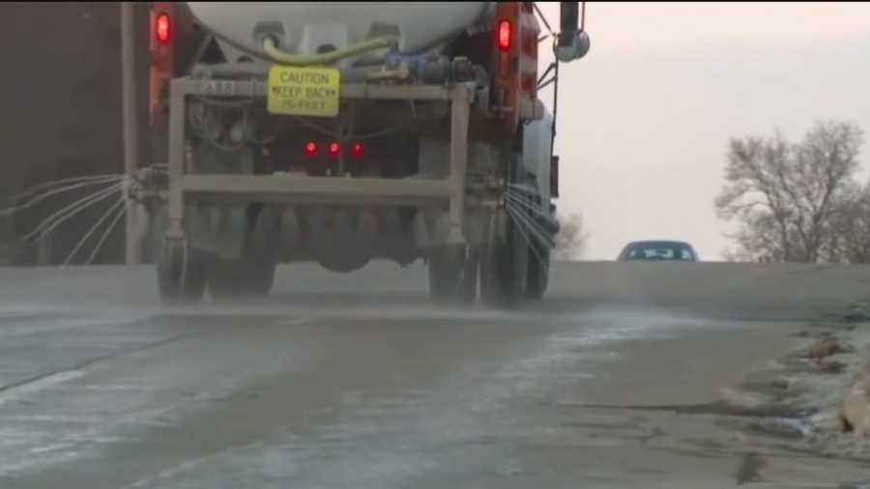
Roadways $\sim$ De-icing salt application
Strong relationship between road density and Na⁺, Cl⁻, and conductivity¹
From 2001 to 2021
Per year in Baltimore County²
More than 8 million dollars
Nearly 61,000 tons of salt
Image from https://www.wbaltv.com/article/salt-brine-used-to-treat-roads-can-damage-your-car/7092181
¹A. M. Wallace et al., 2013; ²https://www.baltimorecountymd.gov/departments/public-works/highways/index.html
Notes:
12oz mug = 10 sidewalk squares
Training and Education
MDE is working on certification programs for winter salt applicators and property owners. The programs will focus on how to keep roads safe while reducing impacts to the environment.

Slide 40
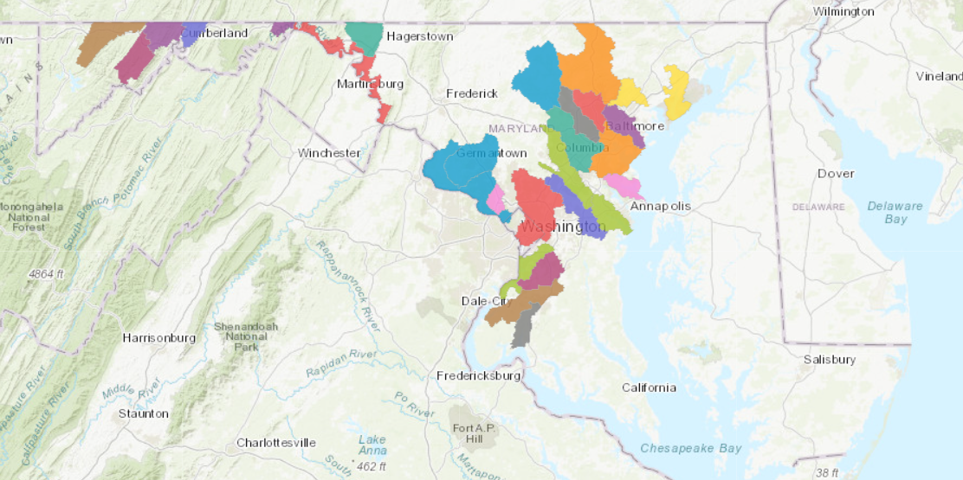
Salt application impairs freshwater ecosystems
Subcategory 5s
Maryland Department of the Environment
Notes:
ubcategory 5s: Waterbody impairment is caused by chloride from road salt. Waters assessed in Category 5s are high priority to be addressed through pollution control requirements and restoration approaches, and lower priority for TMDL development.

Slide 41
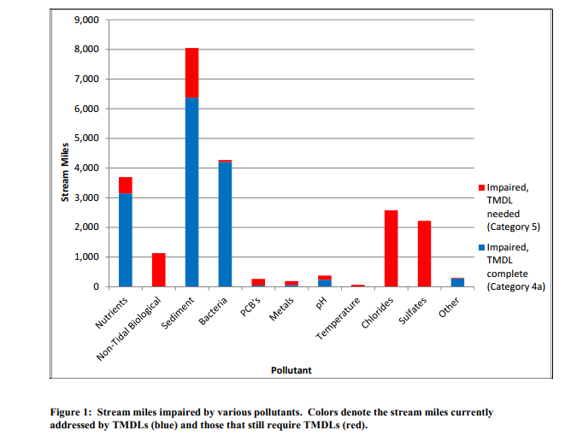
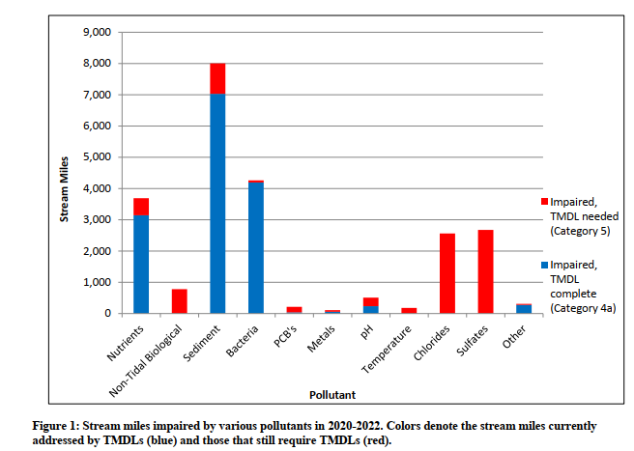
Salt problem still needs to be addressed
Subcategory 5s
Monahan and Stover, 2018
Monahan, 2022
Notes:
ubcategory 5s: Waterbody impairment is caused by chloride from road salt. Waters assessed in Category 5s are high priority to be addressed through pollution control requirements and restoration approaches, and lower priority for TMDL development.

Slide 42


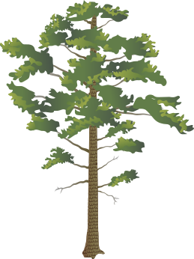
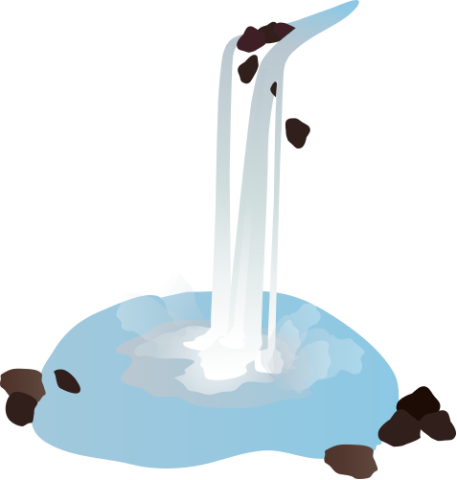
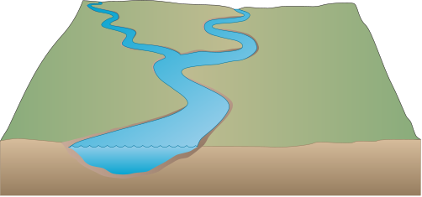



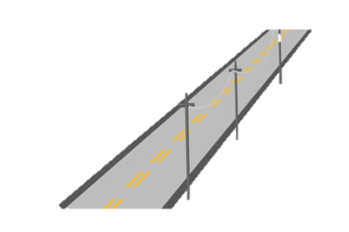
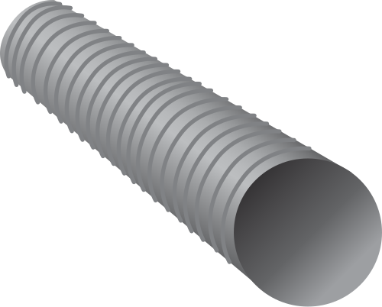

Salt application leads to changes
in water chemistry in urban streams

Slide 43
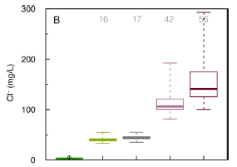
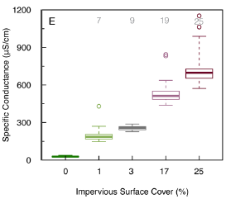
Salt application leads to changes
in water chemistry in urban streams
Elevated concentrations of ions and specific conductance (SC)
In urban streams in the Maryland Piedmont¹
In suburban and urban streams in the Baltimore Metropolitan Area²
Cl⁻ peaked at 5 g/L
Remained elevated throughout the year
¹Moore et al., 2017; ²Kaushal et al., 2005
Notes:
25% sea water; 100 times greater than conc in forested and agricultural streams

Slide 44
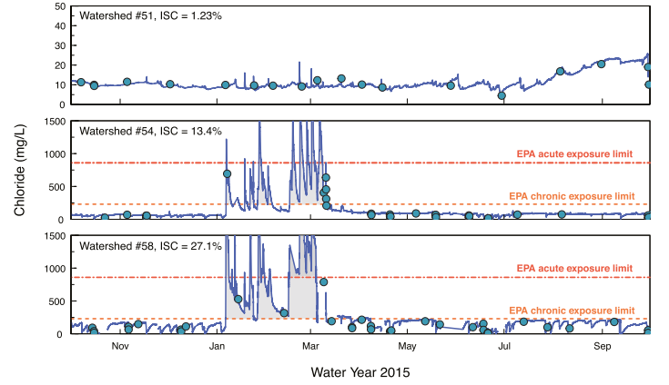
Salt application leads to changes
in water chemistry in urban streams
Mill Creek, VA
Paint Branch, MD
Sligo Creek, MD
¹Moore et al., 2017; ²Kaushal et al., 2005; ³Moore et al., 2020
Notes:
Meanwhile, the concentrations frequently exceeded the chronic (230 mg/L) and acute (860 mg/L) exposure limit by the U.S. Environmental Protection Agency (US EPA, 1988) in Paint Branch (13.4% ISA) and Sligo Creek (27.1% ISA), Maryland (Moore et al., 2020).

Slide 45
Salt application leads to changes
in water chemistry in urban streams
Mill Creek, VA
Paint Branch, MD
Sligo Creek, MD
¹Moore et al., 2017; ²Kaushal et al., 2005; ³Moore et al., 2020
Notes:
Meanwhile, the concentrations frequently exceeded the chronic (230 mg/L) and acute (860 mg/L) exposure limit by the U.S. Environmental Protection Agency (US EPA, 1988) in Paint Branch (13.4% ISA) and Sligo Creek (27.1% ISA), Maryland (Moore et al., 2020).

Slide 46
Salt application leads to changes
in water chemistry in urban streams
Mill Creek, VA
Paint Branch, MD
Sligo Creek, MD
¹Moore et al., 2017; ²Kaushal et al., 2005; ³Moore et al., 2020
Notes:
Meanwhile, the concentrations frequently exceeded the chronic (230 mg/L) and acute (860 mg/L) exposure limit by the U.S. Environmental Protection Agency (US EPA, 1988) in Paint Branch (13.4% ISA) and Sligo Creek (27.1% ISA), Maryland (Moore et al., 2020).

Slide 47
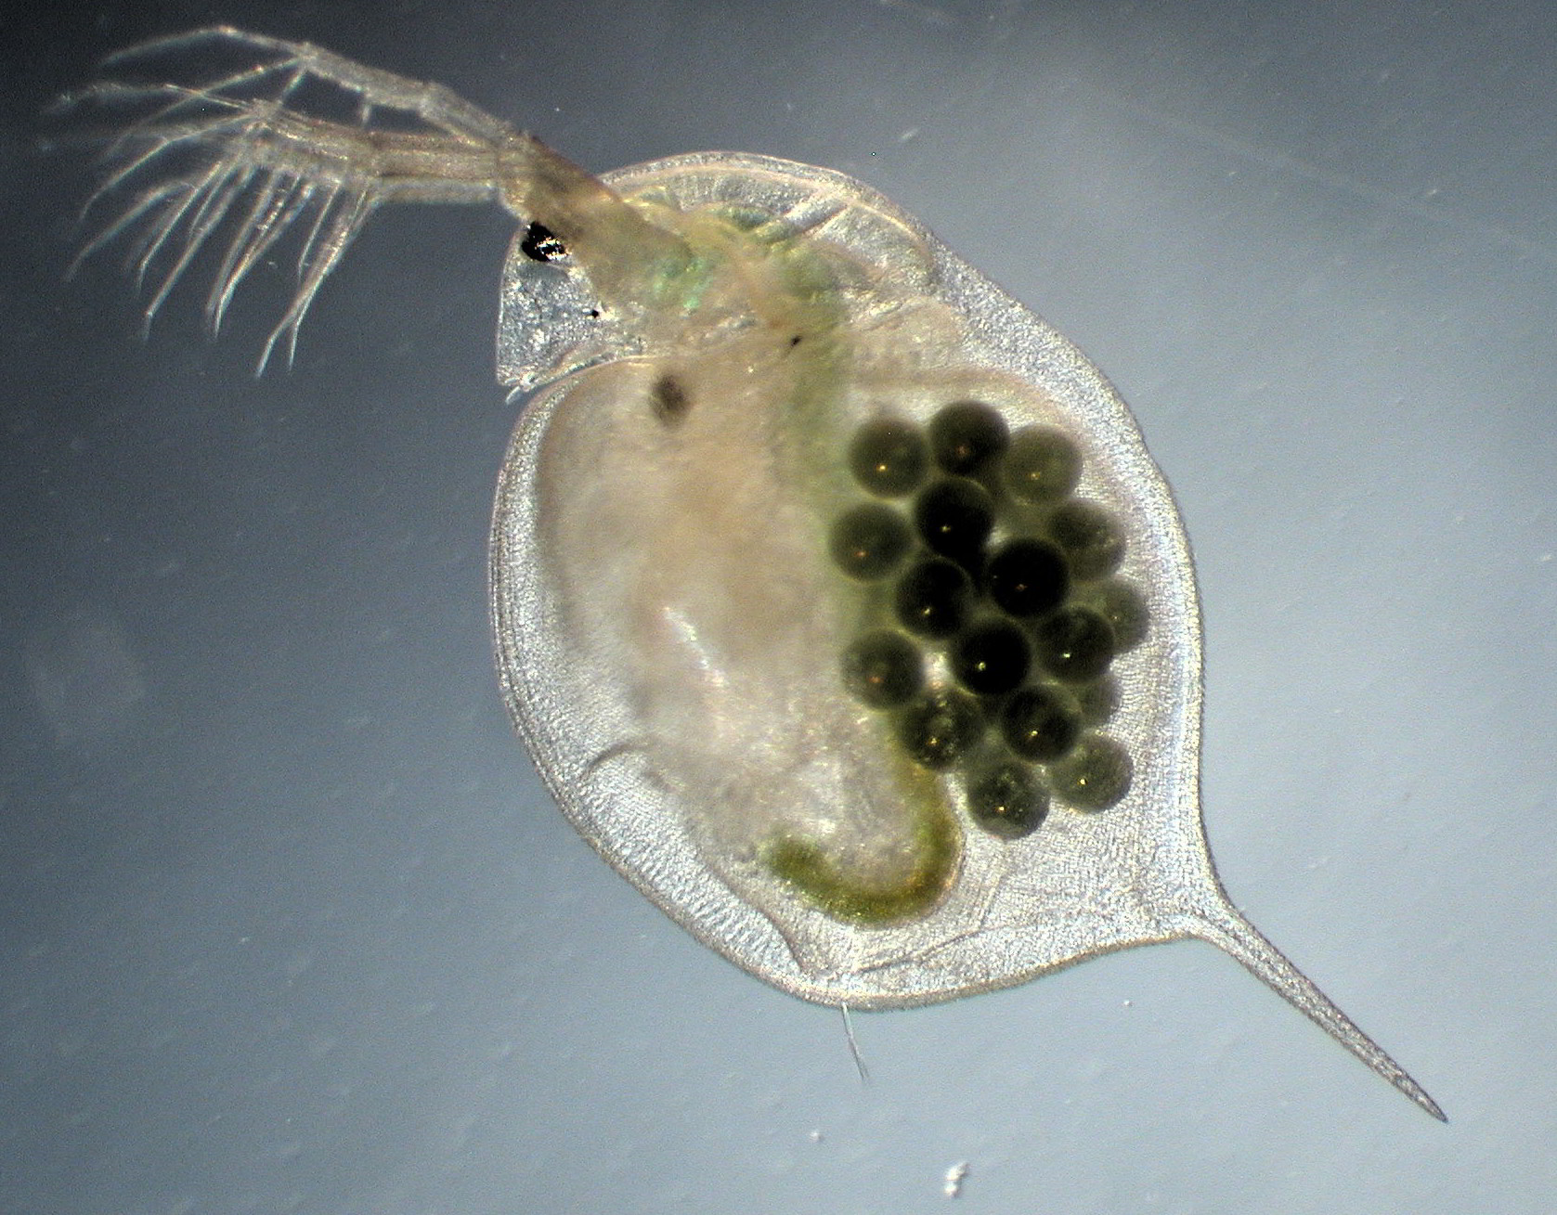
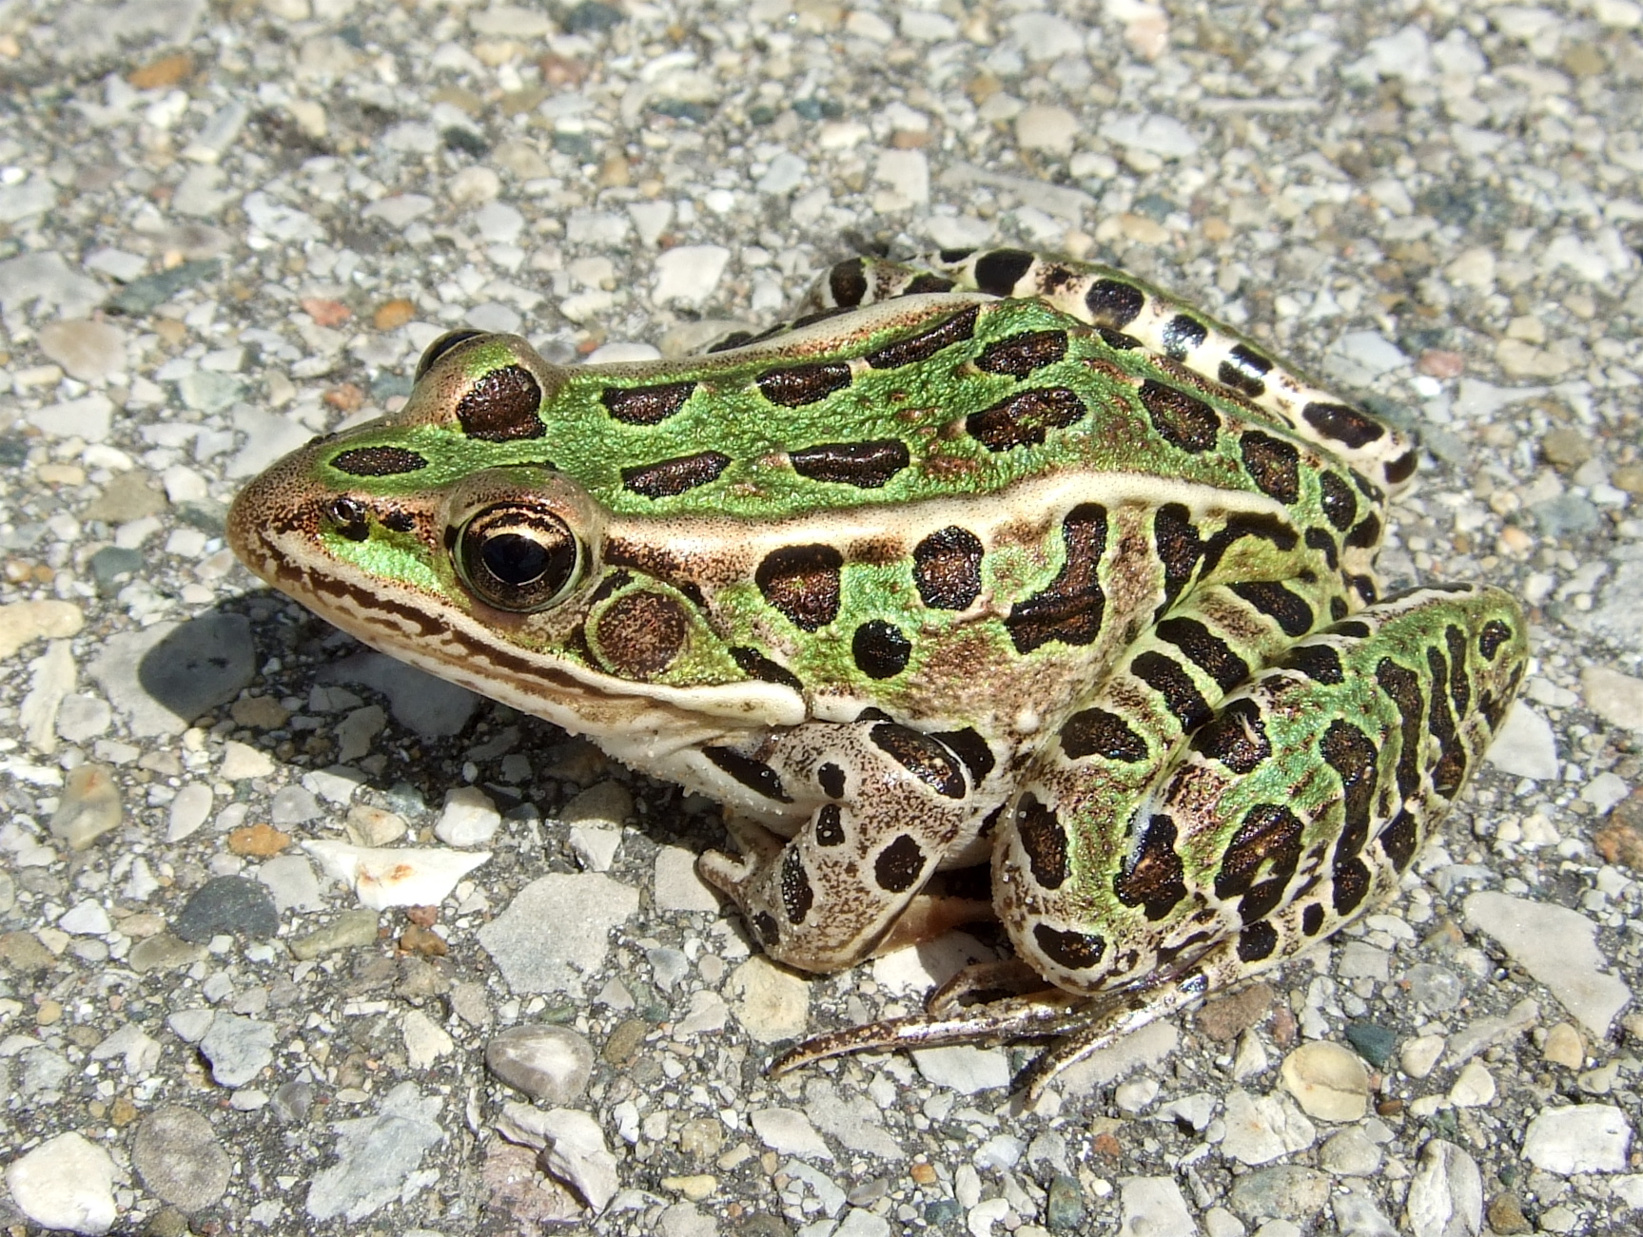
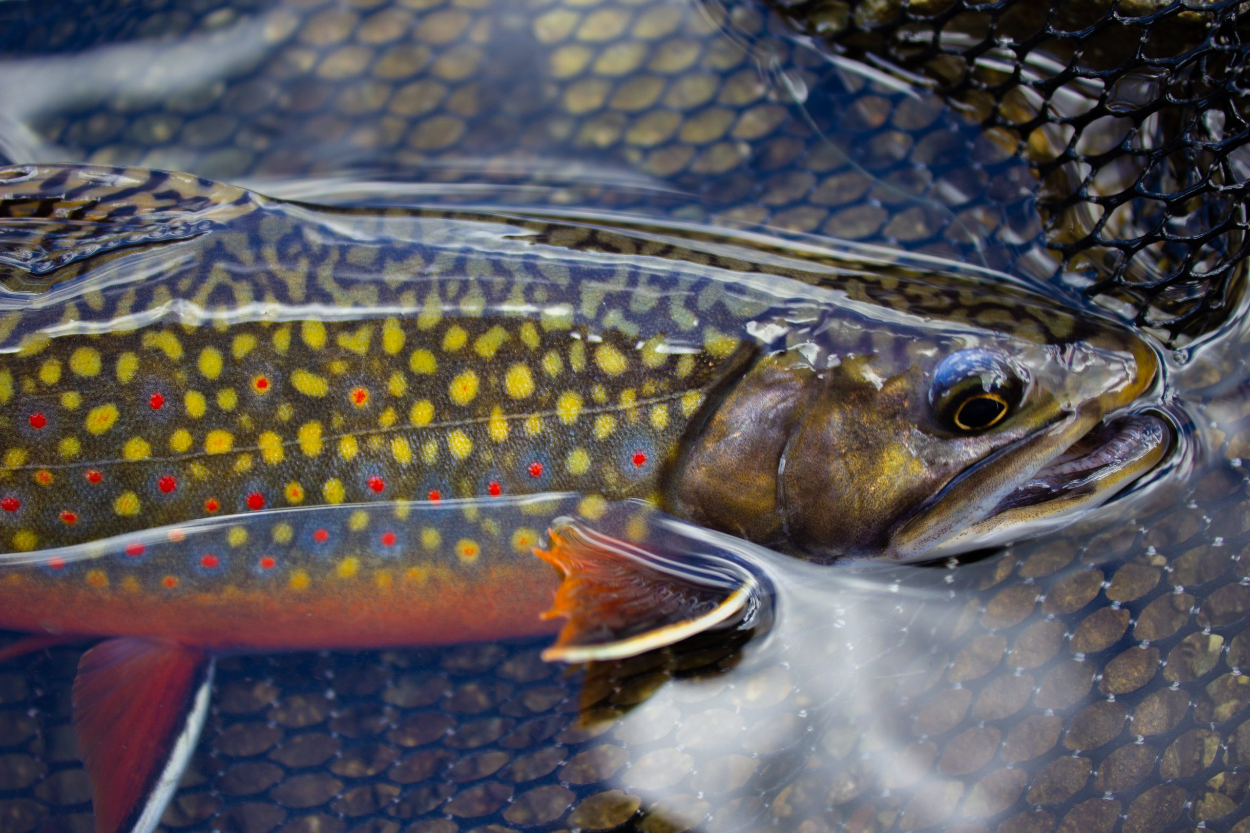
Increased salinity negatively impacts aquatic organisms
Lakes/Ponds
Zooplankton¹
Density
Community composition
Amphibians²
Survival of eggs and pre-metamorphosed larvae
Streams
Fish³
Benthic macroinvertebrates⁴
¹van Meter et al., 2011; ²Bishop et al., 2000; ³Morgan et al., 2012; ⁴A. M. Wallace & Biastoch, 2016

Slide 48
Summary

Slide 49
Summary
1. How did (a) land cover and (b) water chemistry change over the period 1987-2009?
Increases in developed land and SC (also Cl⁻ and Ca²⁺) with great variations among sub-watersheds.
2. How did benthic macroinvertebrate communities respond to rapid urban development?
Benthic assemblages were distinct between 1987 and 2009.
3. What was the likely cause of benthic decline?
Road salt was likely a driving cause of benthic declines, especially at downstream mainstem stations.

Slide 50
Outline
Background Information
Initial phase of rapid urban development
Continuing phase of urbanization
Conclusion

Slide 51
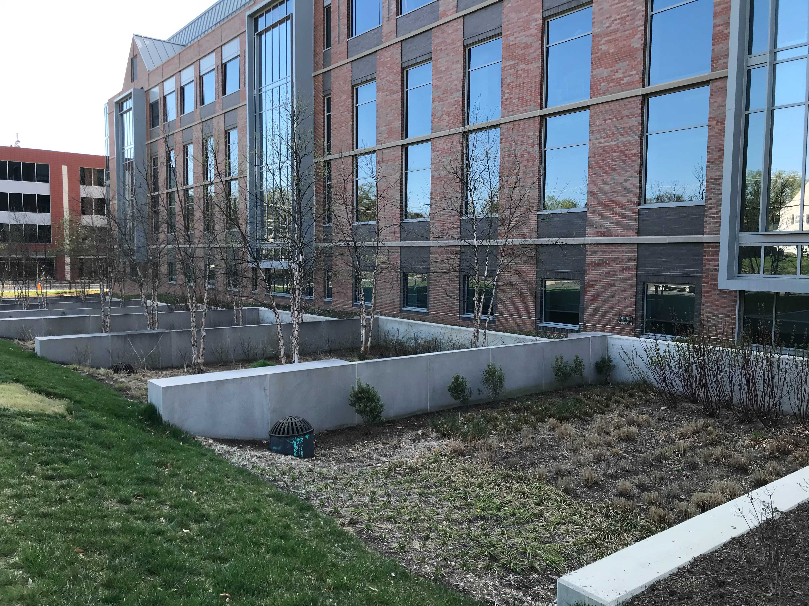



Stormwater management features (SMFs)

Slide 52


Stormwater management features (SMFs)
Functions
$↘$stormwater velocity
$↘$ nutrient & sediment inputs
Habitats for organisms

Slide 53
Index of Biotic Integrity¹
Quick and cost-effective method
Integrates metrics from species richness, composition, and tolerance to stressors
Maryland
Coastal Plain; Piedmont; Combined Highlands
Macroinvertebrates.org
¹Southerland et al., 2005
BugGuide.Net

Slide 54
Index of Biotic Integrity¹
Quick and cost-effective method
Integrates metrics from species richness, composition, and tolerance to stressors
Maryland
Coastal Plain; Piedmont; Combined Highlands
Number of taxa/EPT taxa/Ephemeroptera taxa
Percent intolerant urban
Percent Ephemeroptera
Percent Clinger
Percent Chironomidae
Macroinvertebrates.org
¹Southerland et al., 2005
BugGuide.Net

Slide 55
Research questions
How did (a) land cover and (b) water chemistry change over the period 2009-2019?
How did benthic macroinvertebrate communities respond to the continuing phase of urban development?

Slide 56


Sampling design
Benthic macroinvertebrates
MBSS protocol: D-net
Once per year at randomly selected sites
Data recorded as abundance
Metrics and IBI scores¹ calculated
Water chemistry
Recorded concurrently
¹Southerland et al., 2005
Notes:
Image of MD and RR showing benthic and water quality sampling sites
1990 Report finding about brook trout.
2009 Repeated Sampling: Hess
Water quality sampling: Same stations.
=> Importance of the study: Before and After; paired design

Slide 57
Research questions
How did (a) land cover and (b) water chemistry change over the period 2009-2019?
How did benthic macroinvertebrate communities respond to the chronic state of urban development?

Slide 58

1a. Percent developed land stabilized¹ in two sub-watersheds and slightly increased in the other two.
¹Bird et al., 2018

Slide 59
1a. Percent developed land stabilized¹ in two sub-watersheds and slightly increased in the other two.
¹Bird et al., 2018

Slide 60


1b. SC and ISC had a positive association.

Slide 61
Research questions
How did (a) land cover and (b) water chemistry change over the period 2009-2019?
How did benthic macroinvertebrate communities respond to the continuing phase of urban development?

Slide 62
2. Assemblages from reference stations consistently had higher IBI scores.
REF-017, B9, and US-B7
Good & Fair (3.33 – 4.33)
Other stations
Very Poor & Poor (1.67 – 2.67)
Important metrics
Number of EPT taxa/Ephemeroptera taxa
Percent intolerant urban
Percent Ephemeroptera

Slide 63

After 2014
Before 2014
Before 2014
2014
After 2014
High development
Low development
NMDS ordination of IBI scores and metrics
Reference stations
Before 2014
After 2014

Slide 64

2. Assemblages from reference stations were distinct from others in urbanized sub-watersheds, which were different between before and after 2014.
Chironomidae
Consistent with previous period
Clingers
Hydropsychidae!
High development
Low development
Before 2014
After 2014

Slide 65

SMFs may not be effective in reducing salt inputs into stream^{1,2}
¹Snodgrass et al., 2017; ²Casey et al., 2013

Slide 66
Summary

Slide 67
Summary
How did (a) land cover and (b) change over the period 2009-2019?
(a) Two sub-watersheds entered a stable state of land cover, whereas other two slightly increased in developed land.
(b) SC and ISC had positive association.
2. How did benthic macroinvertebrate communities respond to the chronic state of urban development?
Benthic assemblages were distinct between reference stations and those in urbanized sub-watersheds, which were different before and after 2014.

Slide 68
Outline
Background Information
Initial phase of rapid urban development
Continuing phase of urbanization
Conclusion

Slide 69
Conclusion
De-icing salt application increased SC and major ion concentrations (e.g., Cl⁻, Ca²⁺).
Benthic communities in urbanized sub-watersheds differed between (a) 1987-1988 and 2009 and (b) before and after 2014, with great increases in hydropsychid caddisflies.
Road salt resulted in significant losses of salt-sensitive genera.
SMFs may not be effective in reducing the salt inputs into stream.

Slide 70


QUESTIONS?

